Slide 1
GradStar: Pre-Paid/Nonmonetary Awards
Notes:
In this video we will learn about pre-paid and nonmonetary awards in grad star .

Slide 2
By the end of the course…
Know how to report values of nonmonetary and pre-paid awards in GradStar.
Notes:
By the end of this course, you know how to report values of non-monetary, pre-paid, and tangible awards in GradStar.

Slide 3
Let’s get started…
ack
Notes:
Let’s get started!.

Slide 4
What types of items are considered nonmonetary or pre-paid?
Items given only to students such as:
Gift cards
Electronic Devices (computers, tablets, equipment, etc.)
Giveaways
Promotional, goodwill or incentive gifts
Payments made to outside providers on a student’s behalf
Items purchased using other systems (i.e., BuyCarolina)
De minimis items valued at $25 (or less) can be excluded from being reported in GradStar.
Notes:
Let’s first identity what types of items are considered non-monetary or pre-paid awards.
Non-monetary or pre-paid awards provided only to students ( this means only students are eligible to receive such items) may include gift cards, electronic devices, giveaways, promotional/goodwill/or incentive gifts. Payments made to outside providers on a student’s behalf fall under this award type. Items or awards that are not student specific meaning they are available to students, faculty, staff, or the general public should not be reported in GradStar. Additional de minimum item items valued at $25 or less can be excluded from being reported in Grad Star.

Slide 5
Why do values for nonmonetary/pre-paid awards have to be reported?
To remain compliant with federal financial aid regulations.
Regulations specify that any educational benefits paid because of enrollment in a postsecondary education institution, or to cover postsecondary education expenses is financial assistance.
GradStar is the system used to report financial assistance (both cash and non-cash values) for students.
Notes:
Let’s also briefly discus why these award should be reported in GradStar.
The main reason why these items should be reported is to remain compliant with federal financial aid regulations which state “any educational benefits paid because of enrollment in a post secondary institution OR to cover post secondary education expense is financial assistance “.
As such, we (the University) are required to count benefits, payments, awards to students ( both cash and non-cash value) as financial assistance. And grad star is the system used to report such student benefits/payments.

Slide 6
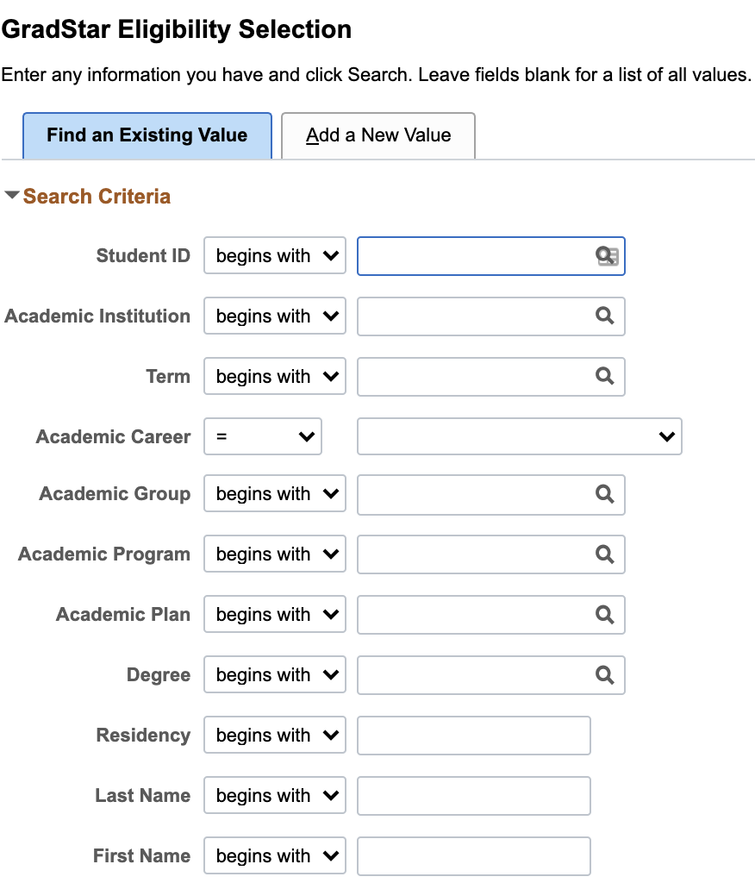
Entering Nonmonetary / Pre-Paid Awards
Mark Student Eligible
Enter 9 Digit Student ID
Academic Institution
UNCCH
Term
Academic Career
Back
Next
Notes:
The first step in reporting values for pre-paid/nonmonetary awards in GradStar is to mark the student eligible on the grad star eligibility selection page. Enter the students 9- digit ID number, academic institution which will always be UNCCH , the term , and the academic year and click search.
See GradStar Step-by Step Guide at https://gradschool.unc.edu/facultystaff/funding/gradstar/

Slide 7
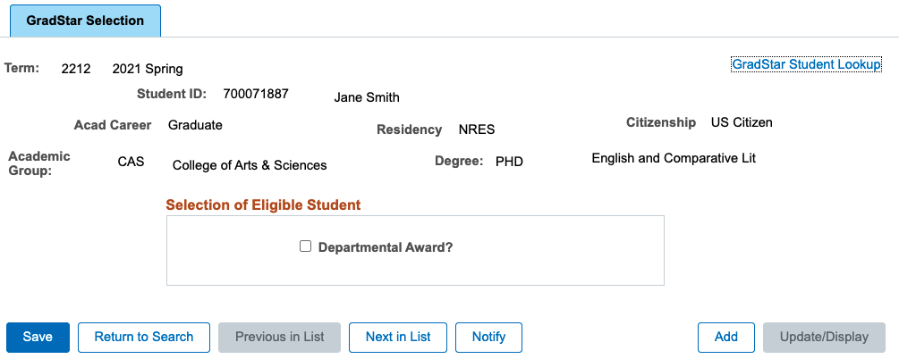
Entering Nonmonetary/ Pre-Paid Awards
Mark Student Eligible
Ensure Degree Program Listed
Click Check box
Save
Click to mark student eligible
Notes:
When you arrive on the eligibility selection page make sure there is a degree and program listed. Next, click the box by departmental award, and save the page.
See GradStar Step-by Step Guide at https://gradschool.unc.edu/facultystaff/funding/gradstar/

Slide 8
Entering Nonmonetary/ Pre-Paid Awards
Use the GradStar Maintenance Page to enter award
Click on Pre-paid/Nonmonetary
Notes:
Navigate to the grad star maintenance page and click on Pre-Paid/Nonmonetary

Slide 9
Entering Nonmonetary/ Pre-Paid Awards
Use the GradStar Maintenance Page to enter award
Enter ‘ NON” award type
Funding Department
Value (amount) of nonmonetary or pre-paid award
Provide a description
Notes:
On the Pre-Paid/ Non-Monetary award page, enter the award type ( which will always be NON), Funding department, and value (or amount) of the nonmonetary/pre -paid award. e sure to provide a description of the award . No account code is assigned to this award types since the award is already provided to the student. Additionally, funds for this award type will not pay against any changes on the student’s account.

Slide 10
Saving The Page
If you have no other awards save the page
Notes:
If there are no other awards to be entered, save the page.

Slide 11
Success
Stay tuned for more helpful trainings.
Notes:
Congratulations! You now know how to report the value of pre-paid and non-monetary awards iin grad star.

